Slide 1
Strategic Management Project: Coca-Cola Company

Slide 2
Introduction
Coca-Cola company is an American based multinational organization.
Its headquarters in Atlanta.
Apart from Coca Cola, other organizational products include Fanta, Sprite, 7Up, Minute Maid, Nestea, and Fruitopia among others.
The main events in the history of Coca-Cola that have facilitated its current success are based on acquisitions.
In 1960 Coca-Cola made its first acquisition of Minute Maid followed by Thums Up in 1993 plus Barg’s in 1995 and the trend continued till 2015 when the organization a minimum stakeholder of Suja Life LLC.
Since the establishment of the organization in 1886, Coca-Cola has continued to offer its consumers a taste that is both unique and refreshing leading it to become the biggest beverage company in the world.

Slide 3
Mission and Vision
Coca Cola believes in:
Being future oriented
Understanding market forces and trends
Coca Cola’s Mission is divided into 3 parts:
Becoming a world-class refreshment that satisfies the bodily, mental and spiritual needs of its consumers
Inspiring moments that are filled with happiness and optimism through their brands and actions thereof.
Making a difference and adding value to the lives of the consumers and all those affected by the brand.

Slide 4
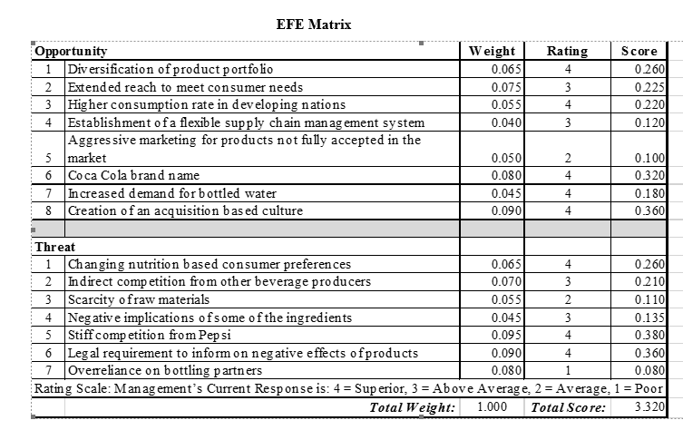
External Assessment of Coca-Cola Company
EFE analysis of Coca-Cola Company

Slide 5
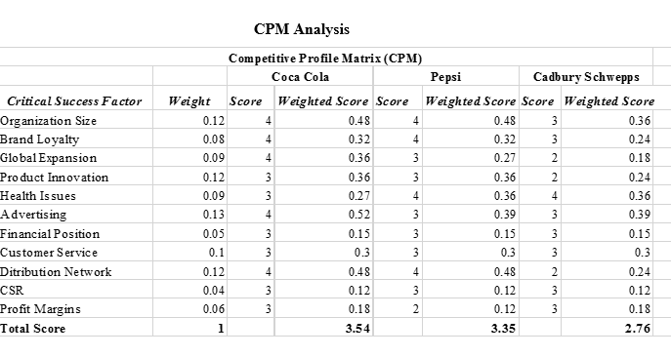
Competitive Profile Matrix (CPM) Analysis of Coca-Cola Company

Slide 6
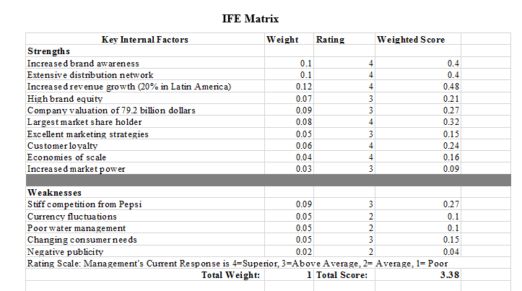
Internal Assessment of Coca-Cola Company
Internal Factor Evaluation (IFE) of Coca-Cola Company

Slide 7
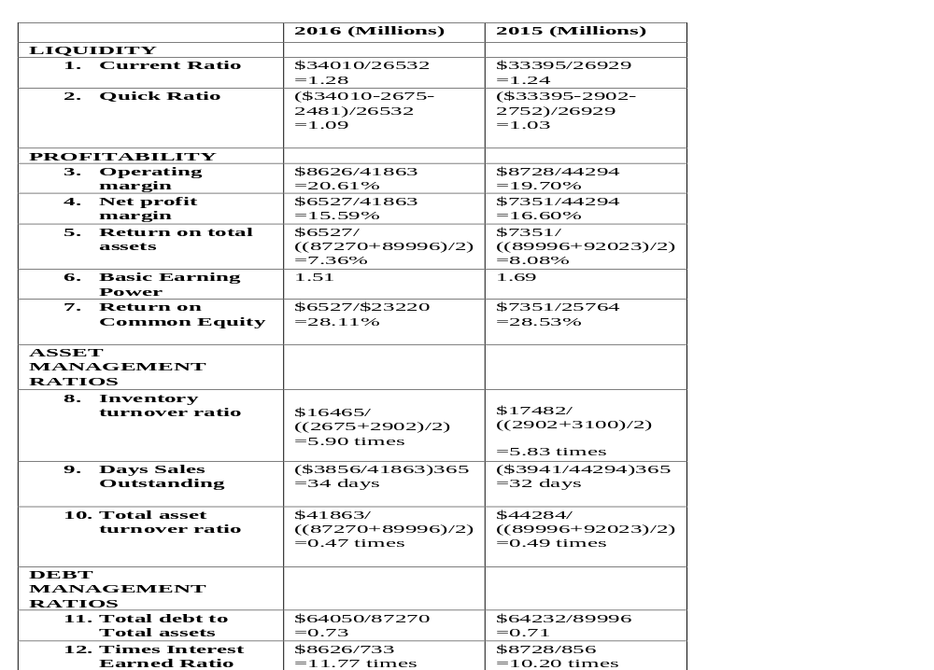
Coca-Cola Financial Ratio Analysis for The Year 2016 And 2015.

Slide 8

Current Strategy
Initially, the founders of the company began their business based on a well-researched market formula.
Additionally, the font that was used to create the Coca-Cola logo in 1923 has remained the same considering that the selection process ensured that it was standardized thus giving it a timeless aspect.
Currently:
Coca-Cola is working towards increasing their revenue and growing their profits through segmented growth strategies.
The organization aligns employee incentives with the prevailing growth rate and in new markets
Coca-Cola is looking to increase the volume of their products while maintaining their affordability
The organization is diversifying their products and price mix through the introduction of small and premium packages in developed markets.
The organization applies technology based marketing strategies

Slide 9
Recommended Strategy Changes
Production healthier drink choices to better suit consumer needs
More effort in dealing with Pepsi (Main Competitor)

Slide 10
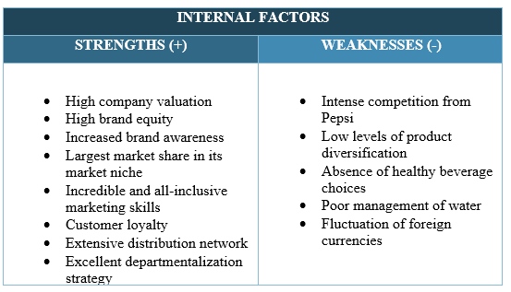
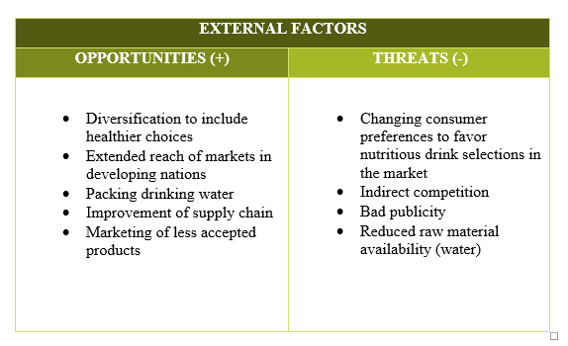
SWOT Analysis of Coca-Cola Company

Slide 11
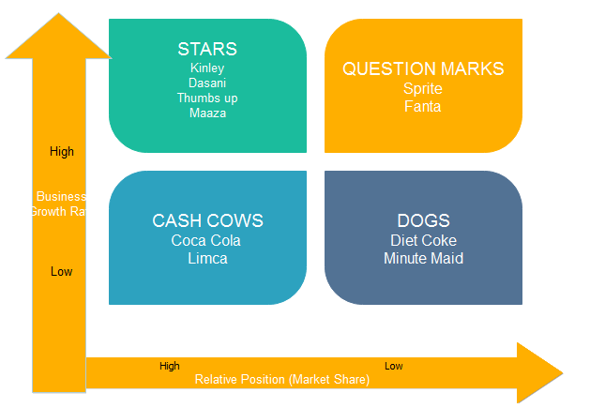
BCG Analysis of Coca-Cola Company

Slide 12
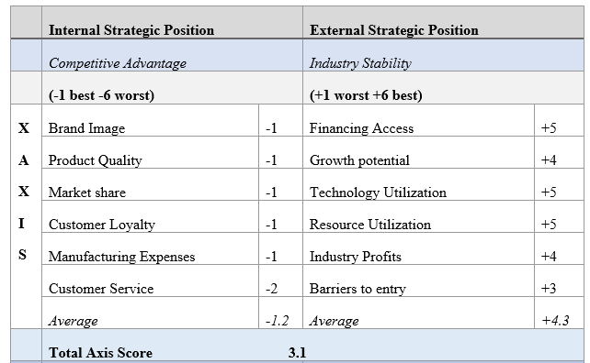
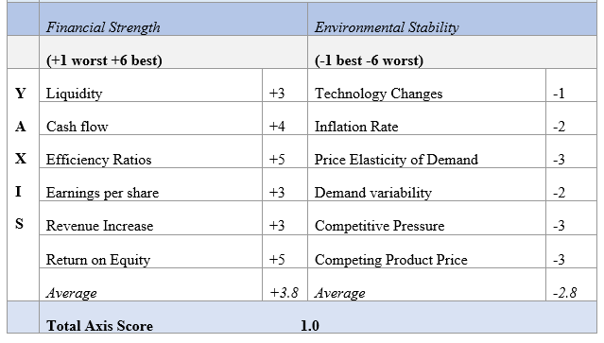
SPACE Analysis of Coca-Cola

Slide 13
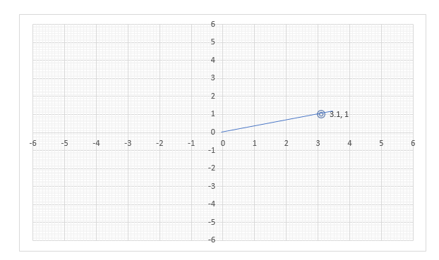
SPACE Matrix Representation

Slide 14
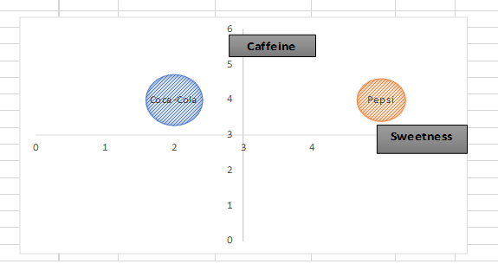
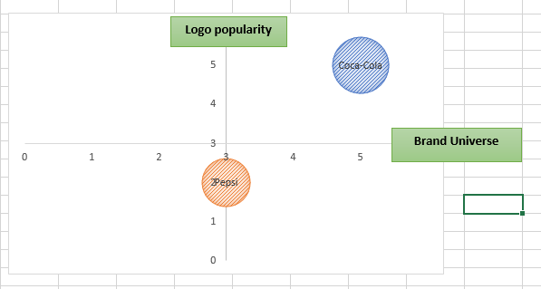
Product- Positioning Map

Slide 15
Strategies and Objectives for most Favorable Market Position
Finding means to eliminate stiff competition from Pepsi through product diversification
Exploration of new product lines that consumers may be more interested in.
Implement better resource management policies
Reinventing supply chain to suit current market needs
Allocating more advertising resources to less popular brands
Eliminate indirect competition by reinventing the organization to become a beverage rather than a soft drink company.

Slide 16
Selected Strategy: Product Portfolio Diversification
As Coca-Cola considers taking on a product portfolio diversification approach to attaining a favorable market position, the organization should use both offensive and defensive tactics.
The defensive approach to product diversification will allow Coca-Cola to:
  Beat the stiff competition from Pepsi.
  Heighten demand for products whose demand has declined
  Increase the number of products the organization offers consumers.
  The defensive approach to product diversification will allow Coca-Cola to:
  Exploit the new market for healthier drinks

Slide 17
Implementation and Assessment Plan
The implementation process will entail:
Conducting market research
Analysis of product adaptation
Legal review
Specific results include:
Control of about 50% of the market share in the next year after implementation of the plan.
Increase organization’s financial stability.
Increase brand value (from 73.1 to 74 billion USD)
Increase revenue (from 41.86 to 42.5 billion USD)
Effectiveness of implementation of plan will be assessed every three months and the results compiled annually.
Documentation of results will be done on charts, tables, graphs, figures and photos as deemed appropriate by a specially formulated strategy assessment team.

Slide 18
Financial Projection
Income Statement
Net operating revenue is expected to increase from $41863 to $73219 million
Gross profit is expected to increase from $ 25398 to $ 53205 million
Net income, income before taxes and consolidated net income are expected to rise significantly with margins of over $12 million over the projected 3-year period.
Statements of Cashflow
Net cash that is accrued from operating activities is expected to increase from $5668 to $ 46634 million
Net cash that is used in investing is also expected to increase from $1794 million to $21153 million
Balance at the beginning of the period is expected to increase from $4093 million to $5182 million while the balance at the end of the period is forecasted to decrease progressively from $7797 million to $5442 million
Balance Sheet
The organizational total assets are expected to double within the three years while total equity is expected to triple. See the spreadsheet below for details.

Slide 19
Income Statements
CONDENSED CONSOLIDATED STATEMENTS OF INCOME (USD $)
In Millions, except Per Share data | 12 Months Ended March. 31, 2017 | 12 Months Ended March. 31, 2018 | 12 Months Ended March. 31, 2019 | 12 Months Ended March. 31, 2020 | 12 Months Ended March. 31, 2020 | 12 Months Ended March. 31, 2021
NET OPERATING REVENUES | $41,863 | ^{48,142} | ^{55,364} | ^{63,668} | ^{73,219} | ^{84,201}
Cost of goods sold | $16,465 | ^{17,288} | ^{18,153} | ^{19,060} | ^{20,013} | ^{21,014}
GROSS PROFIT | 25,398 | 30,854 | 37,211 | 44,608 | 53,205 | 63,187
Selling, general and administrative expenses | 9,439 | ^{10,194} | ^{11,010} | ^{11,890} | ^{12,842} | ^{13,869}
Other operating charges | 7,333 | ^{7,920} | ^{8,553} | ^{9,237} | ^{9,976} | ^{10,775}
OPERATING INCOME | 8,626 | ^{12,740} | ^{17,648} | ^{23,480} | ^{30,387} | ^{38,544}
Interest income | 486 | ⁵¹⁰ | ⁵³⁶ | ⁵⁶³ | ⁵⁹¹ | ⁶²⁰
Interest expense | 733 | ⁷⁷⁰ | ⁸⁰⁸ | ⁸⁴⁹ | ⁸⁹¹ | ⁹³⁶
Equity income (loss) - net
Other income (loss) - net | 243 | ²⁵⁵ | ²⁶⁸ | ²⁸¹ | ²⁹⁵ | ³¹⁰
INCOME BEFORE INCOME TAXES | 8,136 | ^{12,226} | ^{17,108} | ^{22,913} | ^{29,792} | ^{37,919}
Income taxes | 1,586 | ^{1,697} | ^{1,816} | ^{1,943} | ^{2,079} | ^{2,224}
CONSOLIDATED NET INCOME | 6,550 | ^{10,529} | ^{15,292} | ^{20,970} | ^{27,713} | ^{35,694}
Other income | (23) | ⁻ | ⁵ | ⁶ | ⁷ | ⁸
NET INCOME ATTRIBUTABLE TO SHAREOWNERS OF THE COCA-COLA COMPANY | 6,527 | ^{10,529} | ^{15,292} | ^{20,970} | ^{27,713} | ^{35,694}

Slide 20
Statements of Cashflow
CONDENSED CONSOLIDATED STATEMENTS OF CASH FLOWS (USD $)
In Millions | 12 Months Ended March. 31, 2017
OPERATING ACTIVITIES
Consolidated net income | $6,527 | $10,529 | $15,292 | $20,970
Depreciation and amortization | 943 | 1,113 | 2,829 | 4,375
Stock-based compensation expense | 223 | 118 | 211 | 103
Deferred income taxes | (221) | - | - | -
Equity income or loss, net of dividends | 638 | 255 | 268 | 281
Foreign currency adjustments | (39) | ( 28 ) | 21 | ( 12 )
Gains on sales of assets, including bottling interests | (128) | 112 | 215
Other operating charges | 141 | 78 | 25 | 54
Other items | 57 | 45 | 63 | 39
Net change in operating assets and liabilities | (815) | 7,991 | 15,519 | 20,823
Net cash provided by operating activities | 5,668 | 20,213 | 34,443 | 46,634
INVESTING ACTIVITIES
Acquisitions and investments, principally beverage and bottling companies and trademarks | (655) | ( 69 ) | ( 80 ) | ( 92 )
Purchases of other investments | (212) | - | - | -
Proceeds from disposals of bottling companies and other investments | 454 | - | - | -
Purchases of property, plant and equipment | (1,370) | ( 9,559 ) | ( 14,962 ) | ( 20,717 )
Proceeds from disposals of property, plant and equipment | 46 | - | - | -
Other investing activities | (57) | ( 260 ) | ( 299 ) | ( 344 )
Net cash used in investing activities | (1,794) | ( 9,888 ) | ( 15,341 ) | ( 21,153 )
FINANCING ACTIVITIES
Issuances of debt | 5,308 | - | - | -
Payments of debt | (3,211) | ( 417 ) | ( 480 ) | ( 552 )
Issuances of stock | 570 | - | - | -
Purchases of stock for treasury | (1,079) | - | - | -
Dividends | (1,764) | ( 2,882 ) | ( 3,044 ) | ( 3,523 )
Net cash provided by (used in) financing activities | (176) | ( 23,076 ) | ( 34,206 ) | ( 46,380 )
EFFECT OF EXCHANGE RATE CHANGES ON CASH AND CASH EQUIVALENTS | 6 | 2 | 9 | 6
CASH AND CASH EQUIVALENTS
Net increase during the period | 3,704 | ( 2,861 ) | 246 | 260
Balance at beginning of period | 4,093 | 7,797 | 4,936 | 5,182
Balance at end of period | $7,797 | 4,936 | 5,182 | 5,442

Slide 21
Balance Sheets
CONDENSED CONSOLIDATED BALANCE SHEETS (USD $)
In Millions | 12 Months Ended March. 31, 2017 | 12 Months Ended March. 31, 2018 | 12 Months Ended March. 31, 2019 | 12 Months Ended March. 31, 2020
CURRENT ASSETS
Cash and cash equivalents | $4,701 | $4,936.05 | $5,182.85 | $5,442.00
Marketable securities | 278 | $291.90 | $306.50 | $321.82
Trade accounts receivable, less allowances of $57 and $51, respectively | 3,090 | $3,244.50 | $3,406.73 | $3,577.06
Inventories | 2,187 | $2,296.35 | $2,411.17 | $2,531.73
Prepaid expenses and other assets | 1,920 | $2,016.00 | $2,116.80 | $2,222.64
TOTAL CURRENT ASSETS | 12,176 | 12,785 | 13,424 | 14,095
EQUITY METHOD INVESTMENTS | 5,316 | 5,316 | 5,316 | 5,316
OTHER INVESTMENTS, PRINCIPALLY BOTTLING COMPANIES | 463 | 532.45 | 612.3175 | 704.165125
OTHER ASSETS | 1,733 | 1992.95 | 2291.8925 | 2635.67638
PROPERTY, PLANT AND EQUIPMENT, less accumulated depreciation of $6,674 and $6,074, respectively | 8,326 | 17884.8 | 32846.95 | 53563.95
TRADEMARKS WITH INDEFINITE LIVES | 6,059 | 5,756 | 5,756 | 5,756
GOODWILL | 4,029 | 3,828 | 3,636 | 3,454
OTHER INTANGIBLE ASSETS | 2,417 | 2,296 | 2,181 | 2,072
TOTAL ASSETS | 40,519 | 50,391 | 66,065 | 87,598
CURRENT LIABILITIES
Accounts payable and accrued expenses | 6,205 | 5894.75 | 5600.0125 | 5320.01188
Loans and notes payable | 6,066 | 5762.7 | 5474.565 | 5200.83675
Current maturities of long-term debt | 465 | 441.75 | 419.6625 | 398.679375
Accrued income taxes | 252 | 239.4 | 227.43 | 216.0585
TOTAL CURRENT LIABILITIES | 12,988 | 12338.6 | 11721.67 | 11135.5865
LONG-TERM DEBT | 2,781 | 3198.15 | 3677.8725 | 4229.55338
OTHER LIABILITIES | 3,011 | 3462.65 | 3982.0475 | 4579.35463
DEFERRED INCOME TAXES | 877 | 0 | 0 | 0
THE COCA-COLA COMPANY SHAREOWNERS' EQUITY
Common stock, $0.25 par value; Authorized - 5,600 shares; Issued - 3,520 and 3,519 shares, respectively | 880 | 880 | 880 | 880
Capital surplus | 7,966 | 7,966 | 7,966 | 7,966
Reinvested earnings | 38,513 | 49,042 | 64,334 | 85,304
Accumulated other comprehensive income (loss) | (2,674) | (2,674) | (2,674) | (2,674)
Treasury stock, at cost - 1,206 and 1,207 shares, respectively | (24,213) | (24,213) | (24,213) | (24,213)
EQUITY ATTRIBUTABLE TO SHAREOWNERS OF THE COCA-COLA COMPANY | 20,472 | 31,001 | 46,293 | 67,263
EQUITY ATTRIBUTABLE TO NONCONTROLLING INTERESTS | 390 | 390 | 390 | 390
TOTAL EQUITY | 20,862 | 31,391 | 46,683 | 67,653
TOTAL LIABILITIES AND EQUITY | $40,519 | 50,390 | 66,065 | 87,598

Slide 22
References
Armus, S. (2005). Coca-Cola Company. France and the Americas: culture, politics, and history: a multidisciplinary encyclopedia, 1, 273.
Arnett, G. (2015). How Coca-Cola is fighting against a US public losing the taste for it. The Guardian.
Ayub, A., Adeel, R., Muhammad, S. A., & Hanan, I. (2013). A conceptual framework for evaluating SWOT analysis as the mediator in strategic marketing planning through marketing intelligence. European Journal of Business and Social Sciences, 2(1), 91-98.
Baah, S., & Bohaker, L. (2015). The Coca-Cola Company. Culture, 16, 17.
Berry, S. (2010). How Coca-Cola’s distribution system works.
Bethuy, T. W., Black, W. J., Cahill, B. T., Nelson, A. D., & Mehn, P. D. (2007). U.S. Patent No. 7,156,259. Washington, DC: U.S. Patent and Trademark Office.
Blanding, M. (2011). The Coke machine: The dirty truth behind the world's favorite soft drink. Penguin.
Bose, R. (2008). Competitive intelligence process and tools for intelligence analysis. Industrial Management & Data Systems, 510-528.
Butler, D., & Tischler, L. (2015). Design to Grow: How Coca-Cola Learned to Combine Scale and Agility (and how You Can Too). Simon and Schuster.
Cayla, J., & Arnould, E. J. (2008). A cultural approach to branding in the global marketplace. Journal of International Marketing, 86-112.
Chilombo, N., Doetinchem, O., & Kansembe, H. (2008). Financial projections for social health insurance in Zambia. Genève, Organisation mondiale de la santé (non publié).
Clayton, C. W. (2015). The Politics of Justice: Attorney General and the Making of Government Legal Policy. Routledge.
Coffey, T. S. (2008). Diet Coke and Mentos: What is really behind this physical reaction? American Journal of Physics, 551-557.
Company, O., Main, O., Journey, A., Mission, V., Inclusion, D., & Rights, H. et al. (2017). Coca-Cola Journey Homepage. The Coca-Cola Company. Retrieved 28 October 2017, from http://www.coca-colacompany.com/
Company, O., Main, O., Journey, A., Mission, V., Inclusion, D., & Rights, H. et al. (2017). Coca-Cola Leaders. The Coca-Cola Company. Retrieved 28 October 2017, from http://www.coca-colacompany.com/our-company/leadership
Crosetto, P., & Gaudeul, A. (2017). Choosing not to compete: Can firms maintain high prices by confusing consumers? Journal of Economics & Management Strategy, 897-922.
David, F. R. (2011). Strategic management: Concepts and cases. Pearson/Prentice Hall.

Slide 23
Dhalla, R. (2007). The construction of organizational identity: Key contributing external and intra-organizational factors. Corporate Reputation Review, 245-260.
Elliott, B., & Elliott, J. (2007). Financial accounting and reporting. Pearson Education.
Esterl, M. (2016). "Coca-Cola Buys Minority Stake in Suja Life". Wall Street Journal.
Estrel, M. (2015). Coca-Cola Boosted by Sales of Tea, Bottled Water. The Wall Street Journal.
Ferreira, M., Hall, T. K., & Bennett, G. (2008). Exploring brand positioning in a sponsorship context: A correspondence analysis of the Dew Action Sports Tour. Journal of sports management, 734-761.
Fosfuri, A., & Giarratana, M. S. (2009). Masters of war: Rivals' product innovation and new advertising in mature product markets. Management Science, 181-191.
Fournier, S., & Avery, J. (2011). The uninvited brand. Business Horizons, 193-207.
Gelici‐Zeko, M. M., Lutters, D., Klooster, R. T., & Weijzen, P. L. G. (2013). Studying the influence of packaging design on consumer perceptions (of dairy products) using categorizing and perceptual mapping. Packaging Technology and Science, 215-228.
Halmagyi, N., & Yasnov, V. (2009). The spectral curve of the lens space matrix model. Journal of High Energy Physics, 2009(11), 104.
Helms, M. M., & Nixon, J. (2010). Exploring SWOT analysis–where are we now? A review of academic research from the last decade. Journal of strategy and management, 3(3), 215-251.
Hoke, O., Campbell, B., Brand, M., & Hau, T. (2017). Impact of Information on Northeastern US Consumer Willingness to Pay for Aronia Berries. HortScience, 395-400.
Jacobs, M. A., & Swink, M. (2011). Product portfolio architectural complexity and operational performance: Incorporating the roles of learning and fixed assets. Journal of Operations Management, 677-691.
Krützkamp, K. (2013). Celebrity-Marketing: Market penetration by image transfer from stars using the example of the brand Coca-Cola light of the beverage producer Coca-Cola.
Levin, R. (2013). Driving the top line with technology: An interview with the CIO of Coca-Cola. McKinsey Insights and Publications.
McKelvey, S. M. (2006). Coca-Cola vs. PepsiCo-A" Super" Battleground for the Cola Wars? Sports Marketing Quarterly, 114.
McLellan, H. (2006). Corporate storytelling perspectives. The Journal for Quality and Participation, 29(1), 17.

Slide 24
McQuarrie, E. F. (2015). The market research toolbox: a concise guide for beginners. Sage Publications.
Nair, A., & Selover, D. D. (2012). A study of competitive dynamics. Journal of Business Research, 355-361.
Palia, A. P., De Ryck, J., & Mak, W. K. (2014). Interactive Online Strategic Market Planning with the Web-based Boston Consulting Group (BCG) Matrix Graphics Package. Developments in Business Simulation and Experiential Learning, 29.
Pendergrast, M. (2013). For god, country, and coca-cola. Basic Books.
Pike, A. (2009). Brand and branding geographies. Geography Compass, 3(1), 190-213.
Quester, P. G., McGuiggan, R. L., Perreault, W. D., & McCarthy, E. J. (2004). Marketing: creating and delivering value.
Raisch, S., Birkinshaw, J., Probst, G., & Tushman, M. L. (2009). Organizational ambidexterity: Balancing exploitation and exploration for sustained performance. Organization Science, 685-695.
Schneider, S. (2016). How to design a measurable shared value strategy: the case of Coca-Cola Brazil (Doctoral dissertation).
Sinha, J. I., & Rosenthal, E. C. (2009). The costs and perils of over-targeting in today's markets. The Marketing Review, 243-250.
Sirmon, D. G., Gove, S., & Hitt, M. A. (2008). Resource management in dyadic competitive rivalry: The effects of resource bundling and deployment. Academy of Management Journal, 919-935.
Sohel, S. M., Rahman, A. M. A., & Uddin, M. A. (2014). Competitive profile matrix (CPM) as a competitors’ analysis tool: A theoretical perspective. International Journal of Human Potential Development, 3(1), 40-47.
Solomon, M. R. (2009). Marketing: Real people, real decisions. Pearson Education.
Sridhar, G., & Mishra, D. (2011). Executives social representation of rurality and product adaptation: a case of rural markets in India. Asia Pacific Journal of Marketing and Logistics, 285-303.
Steinhardt, G. (2010). Extending product life cycle stages. In the Product Manager's Toolkit (pp. 69-76). Springer Berlin Heidelberg.
Thomas, M. (2009). Belching out the devil: Global Adventures with Coca-Cola. Nation Books.
Wedel, M., & Kamakura, W. A. (2012). Market Segmentation: Conceptual and methodological foundations (Vol. 8). Springer Science & Business Media.
Zishan, F. (2017). PROJECT REPORT ON COCA-COLA COMPANY SUBMITTED BY · MUTHU KUMARAN. Academia.edu. Retrieved 29 October 2017, from http://www.academia.edu/7569416/PROJECT_REPORT_ON_COCA-COLA_COMPANY_SUBMITTED_BY_MUTHU_KUMARAN

